Slide 2
Expert
Circus
Performance
Novice
Slapstick
Entertainment

Slide 3
ㄱ
Master
Acrobat
Expertise
Reviewer
Entertainer
Amusement

Slide 4

Total
View
Circus
Slapstick
Expert
Novice
Performance
Entertainment

Slide 5

Circus
Expert
Slapstick
Total View
Novice
Performance
Entertainment

Slide 6

Circus
41 EA
Expert
32 EA
Slapstick
17 EA
Number of moments
Novice
3 EA
Performance
Entertainment

Slide 7
ㄱ
Acrobat
41 EA
Master
32 EA
Entertainer
17 EA
Number of video
Reviewer
3 EA
Expertise
Amusement

Slide 8

Circus
143 K
Expert
95 K
Slapstick
131 K
Average view
Novice
86 K
Performance
Entertainment

Slide 9

ㄱ
Acrobat
4.95 M
Master
2.69 M
Entertainer
1.85 M
Total view
Reviewer
0.2 M
Expertise
Amusement

Slide 10
3
21
33
Novice
Slapstick
Expert
Circus
40

Slide 11
31%
29%
Novice
Slapstick
Expert
Circus
36%
42%

Slide 12
ㄱ
Acrobat
Fortune
Setup Time
Control View

Slide 13
Start
Chase
Result
Damaged
Searching
Stealth
Detected
Attack
Defence
or
Escape
Start
Chase
Result
Tension
Chase Process

Slide 14
Start
Chase
Result
Tension
Chase Process

Slide 15
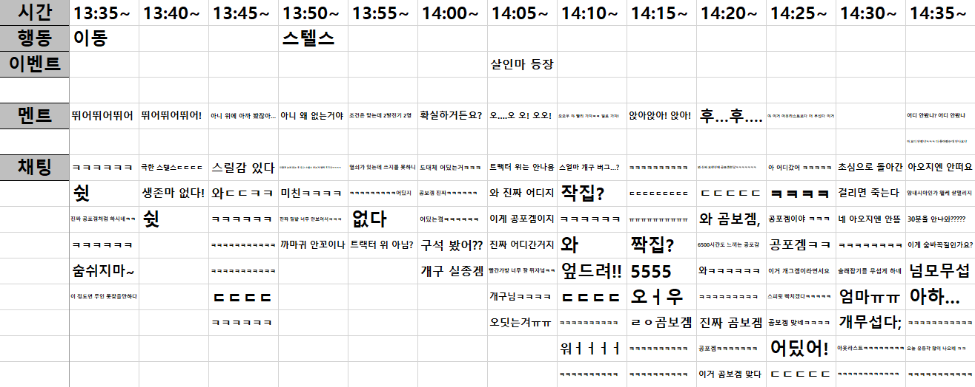
Intro
Chase
Ending

